Slide 1


INSTITUTE : UIE
DEPARTMENT : CSE
Bachelor of Engineering (Computer Science & Engineering)
PROJECT BASED LEARNING IN JAVA
(20CST-319/20ITT-319)
TOPIC OF PRESENTATION:
Use of wrapper classes in Java- Integer, Character, Long, Boolean. Autoboxing and Unboxing.
DISCOVER . LEARN . EMPOWER

Slide 2

Lecture Objectives
In this lecture, we will discuss:
Use of wrapper classes in Java- Integer, Character, Long, Boolean. Autoboxing and Unboxing.

Slide 3
Wrapper Classes
Primitive data types are not used as objects in Java
However, many Java methods require the use of objects as arguments. For example, the add(object) method in the ArrayList
Java offers a convenient way to incorporate, or wrap, a primitive data type into an object. Corresponding class is called a Wrapper Class
For example, wrapping int into the Integer class, and wrapping double into the Double class
Most wrapper class names for a primitive type are the same as the primitive data type name with the first letter capitalized. The exceptions are Integer and Character.
Java provides Boolean, Character, Double, Float, Byte, Short, Integer, and Long wrapper classes for primitive data types
These classes are grouped in the java.lang package.

Slide 4
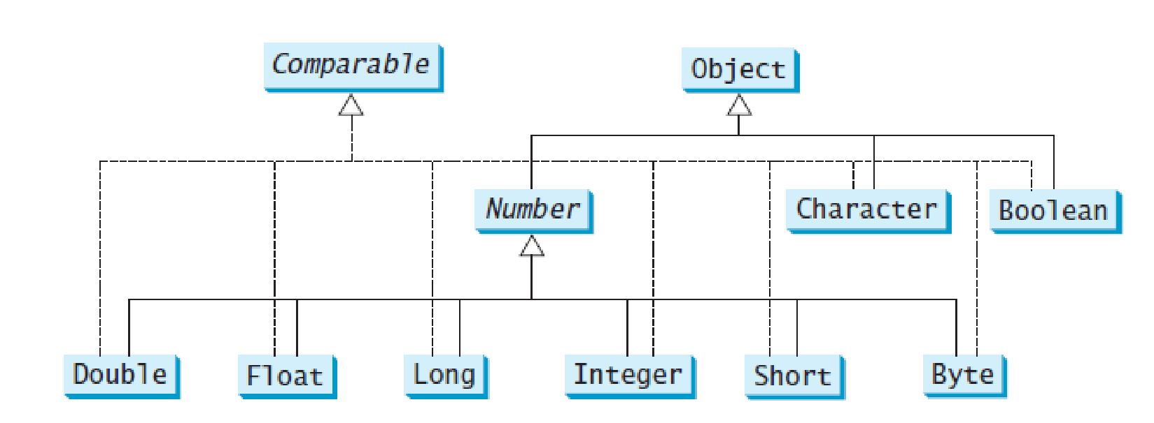
Inheritance Hierarchy of Wrapper Classes

Slide 5
Double and Float
Double and Float
Constructors
Double(double num)
Double(String str) throws NumberFormatException
Float(double num)
Float(float num)
Float(String str) throws NumberFormatException
Constants ( static )
MAX_VALUE Maximum positive value
MIN_VALUE Minimum positive value
NaN Not a number
POSITIVE_INFINITY Positive infinity
NEGATIVE_INFINITY Negative infinity
TYPE The Class object for float or double
SIZE Number of bits used to represent double type

Slide 6
Double and Float
Methods in java.lang.Double
static int compare(double d1, double d2)
int compareTo(Double anotherDouble)
boolean equals(Object obj)
boolean isInfinite()
boolean isNaN()
static double parseDouble(String s)
String toString()
static Double valueOf(String s)
static String toHexString(double d)
Similar methods in java.lang.Float but with float or Float argument

Slide 7
Integer
Integer
Constructors
Integer(int value)
Integer(String s)
Constants (static)
MAX_VALUE Maximum positive value
MIN_VALUE Minimum positive value
TYPE The Class object for float or double
SIZE Number of bits used to represent int type

Slide 8
Integer
Methods in java.lang.Integer
int compareTo(Integer anotherInteger)
double doubleValue() // similarly intValue(), byteValue(), floatValue(), shortValue()
boolean equals(Object obj)
static int parseInt(String s)
static int parseInt(String s, int radix)
static String toBinaryString(int i) // toHexString(), toOctalString()
String toString()
static String toString(int i)
static Integer valueOf(String s)
static Integer valueOf(String s, int radix)

Slide 9
Character
Character
Constructors
Character(char ch)
Constants (static)
MAX_VALUE The largest character value
MIN_VALUE The smallest character value
TYPE The Class object for char
SIZE The number of bits used to represent a char value

Slide 10
Character
Methods in java.lang.Character
static boolean isDefined(char ch)
static boolean isDigit(char ch)
static boolean isLetter(char ch)
static boolean isLetterOrDigit(char ch)
static boolean isLowerCase(char ch)
static boolean isSpaceChar(char ch)
static boolean isUpperCase(char ch)
static boolean isWhitespace(char ch)
static char toLowerCase(char ch)
static char toUpperCase(char ch)

Slide 11
Boolean
Boolean
Constructors
Boolean(boolean boolValue)
Boolean(String boolString)
Methods in java.lang.Boolean
int compareTo(Boolean b)
boolean equals(Object boolObj)
static boolean parseBoolean(String str)
String toString( )
static String toString(boolean boolVal)
static Boolean valueOf(String boolString)

Slide 12
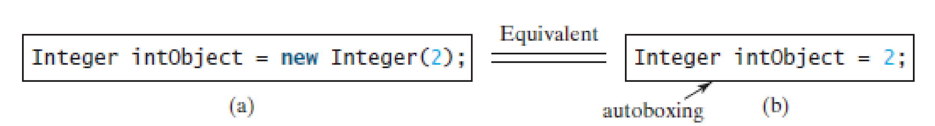
Boxing and Unboxing
Java allows primitive types and wrapper classes to be converted automatically
Converting a primitive value to a wrapper object is called Boxing
The reverse conversion is called Unboxing

Slide 13
Boxing and Unboxing
class AutoBox {
public static void main(String args[]) {
Integer iOb = 100; // autobox an int
int i = iOb; // auto-unbox
System.out.println(i + " " + iOb);
}
}
displays 100 100

Slide 14
Summary:
In this session, you were able to :
Learn about Wrapper Classes.

Slide 15
References:
Books:
1. Balaguruswamy, Java.
2. A Primer, E.Balaguruswamy, Programming with Java, Tata McGraw Hill Companies
3. John P. Flynt Thomson, Java Programming.
Reference Links:
https://www.javatpoint.com/post/java-character
https://www.javatpoint.com/wrapper-class-in-java
https://www.javatpoint.com/java-boolean
Video Link:
https://youtu.be/9ch_rkRwk1M
https://youtu.be/RBHtgLSUiw0

Slide 16

THANK YOU

